Slide 1


Slide 2
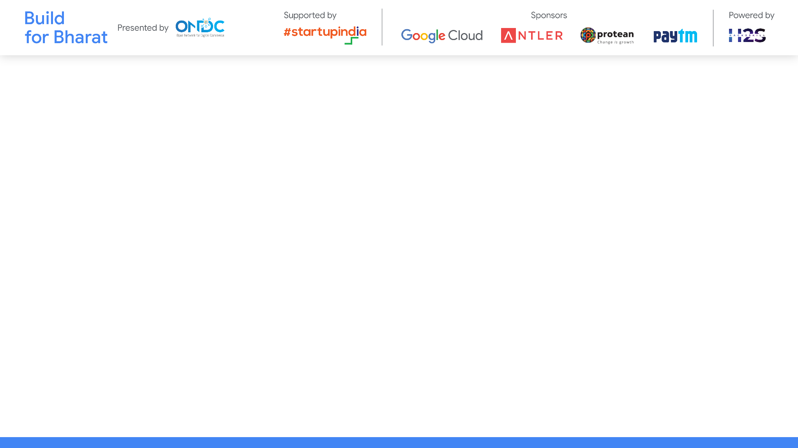
Team Name:Digital Pioneers
Team Leader Name:Ryan Baptista
Team Member Names:
1)Dhayanithi T 2)Mrudulla A P 3)Jisna Hameed
Problem Statement Category: Foundational or Scalable Solution
Problem Statement: THEME: Retail Commerce
PROBLEM NAME: Legal compliance & product safety
*You can make a copy of the slides. Do not change the template branding.

Slide 3
Define customization & deployment options of your proposed solution.
a)Created custom websites excel sheet by taking data in an array.
b)Deployed the project on streamlit which accepts the excel file for analysis.
*You can make a copy of the slides. Do not change the template branding.

Slide 4
Test cases & data (as applicable) against which the eval criteria can be assessed
a)Takes a list of websites as follows:
i)https://fssai.gov.in/cms/product-standards.php
ii)https://consumeraffairs.nic.in/acts-and-rules/legal-metrology/the-legal-metrology-act-2009
iii) https://www.meity.gov.in/esdm/standards
b)Taken a dummy website which was changed later on to check for detection of changes to the website and the corresponding e-mail to the user.
Link:https://github.com/RoquaSpartan95/BuildForBharat/tree/main/Test%20cases
*You can make a copy of the slides. Do not change the template branding.

Slide 5
Demonstrate working of the solution to the evaluation team
Creating an array of a list of websites and storing them in an excel worksheet using .ipynb
Using excel worksheet to access the websites and scraping data from them to store and compare for further changes to the websites.
If there are changes notifying the customer by e-mail.
IF there are no changes continue by saying no changes to the given website.
*You can make a copy of the slides. Do not change the template branding.

Slide 6
Important Links:-
GitHub Public Repository Link:https://github.com/RoquaSpartan95/BuildForBharat
Link to test cases:https://github.com/RoquaSpartan95/BuildForBharat/tree/main/Test%20cases
And data files :https://github.com/RoquaSpartan95/BuildForBharat/tree/main/web%20dev
*You can make a copy of the slides. Do not change the template branding.

Slide 7


